Slide 1
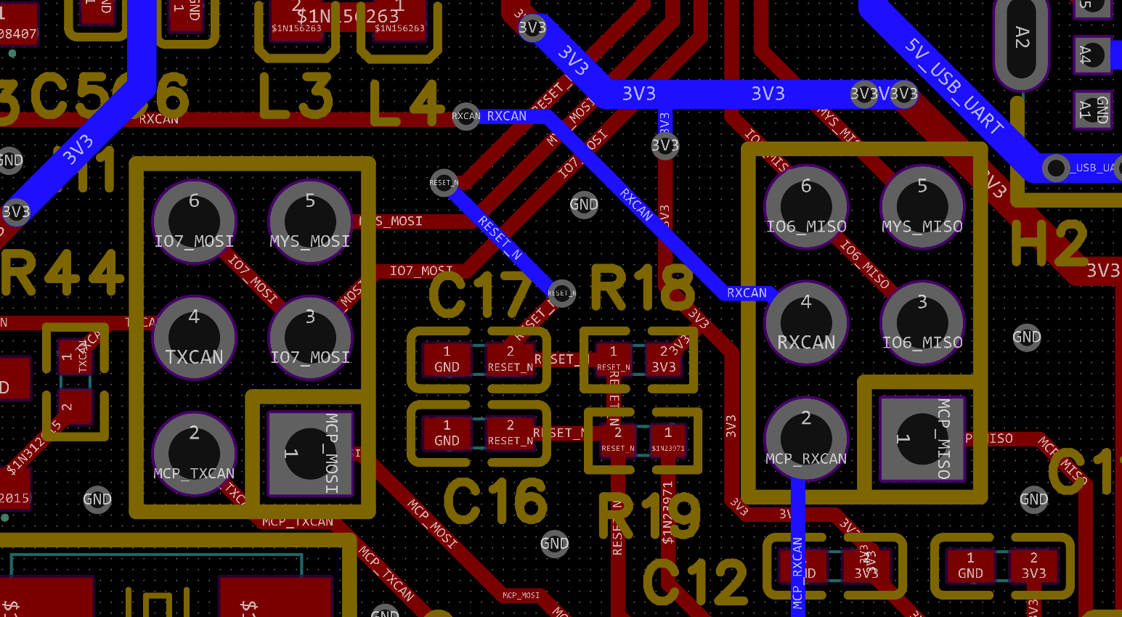
ESP32 C3 Pinout
Jumper Setting 1
SPI to CAN Controller
CAN Controller to CAN transceiver
ESP GPIO | Description | Mapping to Spring Connector | Mapping to Pin Header
GPIO0 | Alive LED (active high) | Pin 6
GPIO1 | MCP2515 RESET |  | Pin 7
GPIO2 | MCP2515 SPI CS
GPIO3 | MCP2515 INT_N (low active) |  | Pin 1
GPIO4 | I2C SCL (pullup) | Pin 3 | Pin 9
GPIO5 | I2C SDA (pullup) | Pin 4 | Pin 10
GPIO6 | Jumper 1: MCP2515 SPI MISO Jumper 2: CAN RX Jumper 4: MYS_MISO |  | Jumper 4: Pin 3
GPIO7 | Jumper 1: MCP2515 SPI MOSI Jumper 2: CAN TX Jumper 3: TX LED (active high) Jumper 4: MYS_MOSI |  | Jumper 4: Pin 6
GPIO8 | Relay (active high) | Pin 5 | Pin 2
GPIO10 | MCP2515 SCLK |  | Pin 5
Jumper Setting 2
ESP -> Can Transceiver
Jumper Setting 3
IO7 → TX LED
Jumper Setting 4 IO7_MOSI → MYS_MOSI
IO6_MISO → MYS_MISO

Slide 2
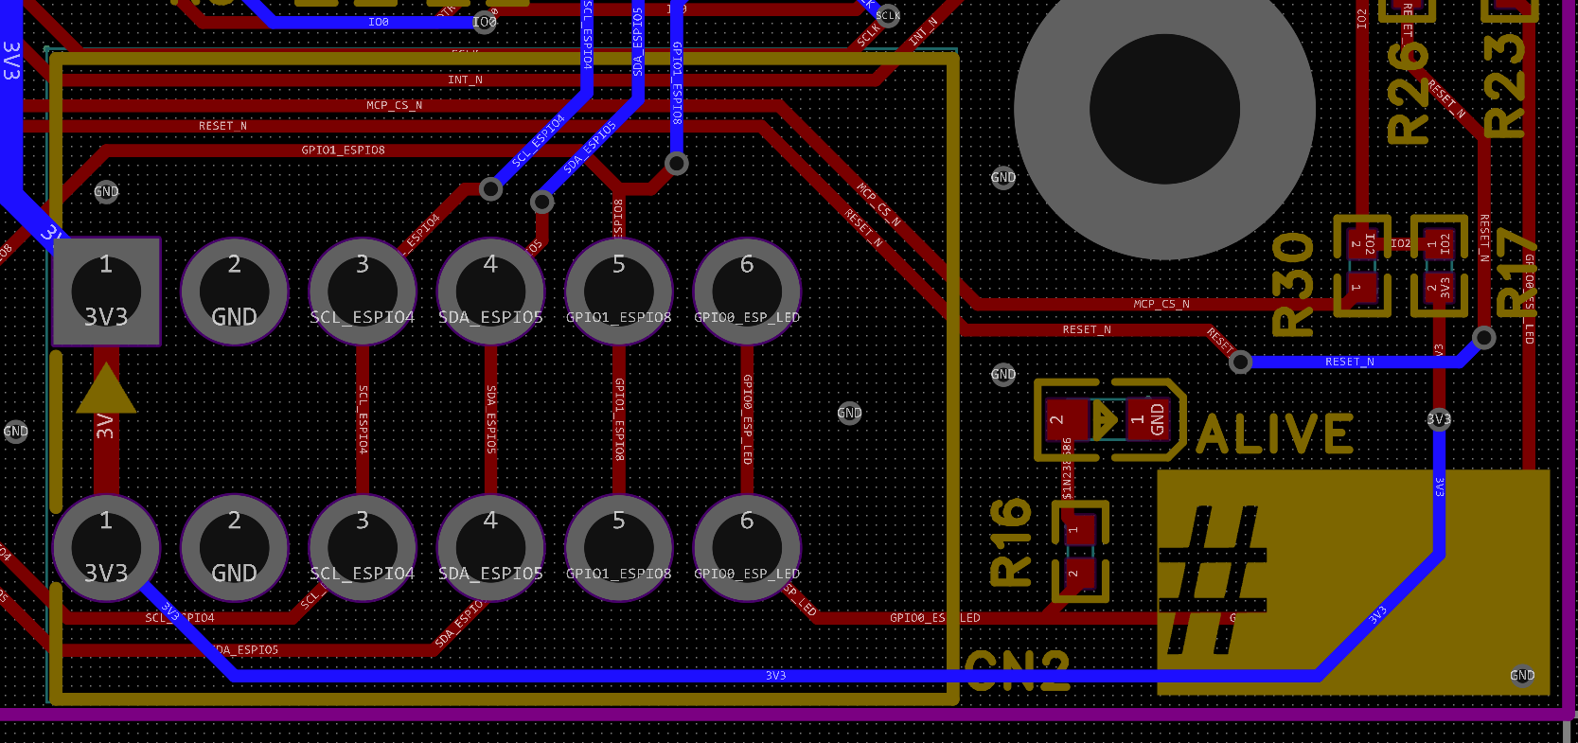
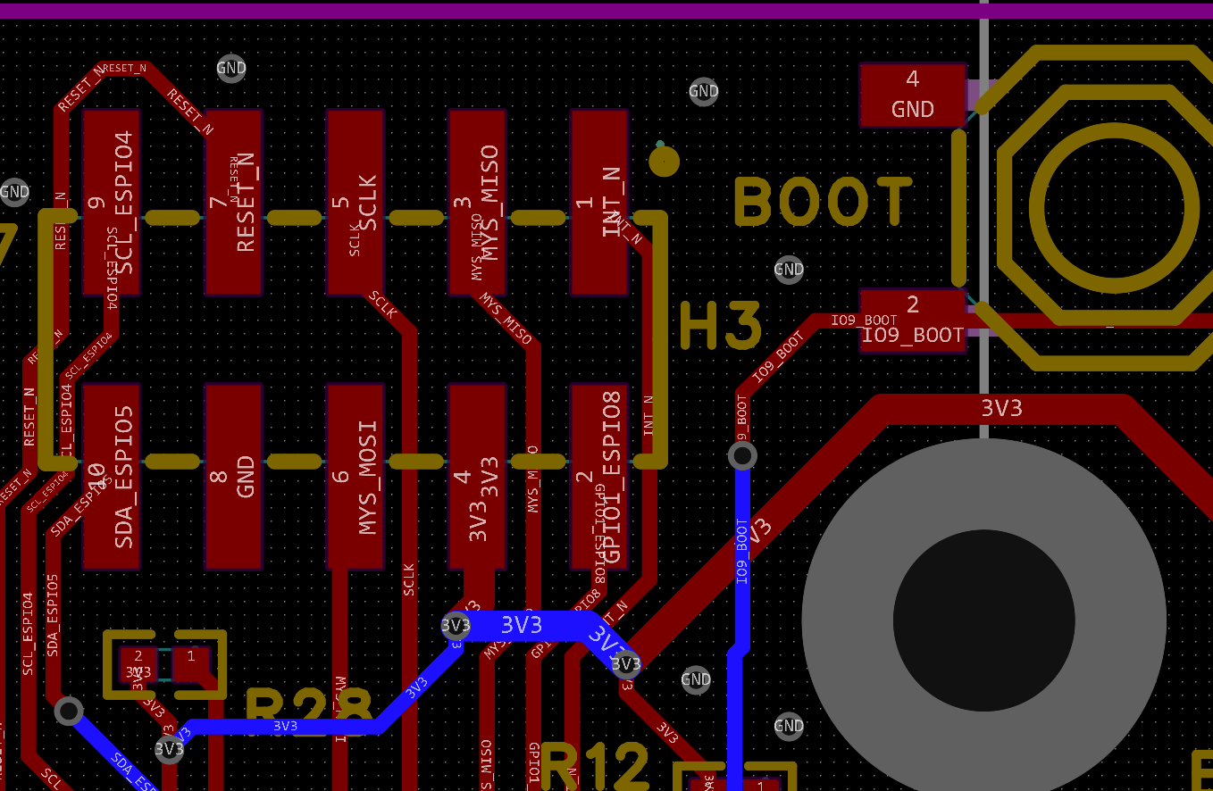
Spring Clamps
Jumper
MYS Pin Header

Slide 3
ESP32 direct CAN mode
CAN via MCP2515
ESP GPIO | Description | Mapping to Spring Connector | Mapping to Pin Header
GPIO0 | Alive LED (active high) | Pin 6
GPIO4 | Binary Sensor (low active) | Pin 3 | Pin 9
GPIO6 | Jumper 2: CAN RX |  | Jumper 4: Pin 3
GPIO7 | Jumper 2: CAN TX |  | Jumper 4: Pin 6
ESP GPIO | Description | Mapping to Spring Connector | Mapping to Pin Header
GPIO0 | Alive LED (active high) | Pin 6
GPIO1 | MCP2515 RESET (optional) |  | Pin 7
GPIO2 | MCP2515 SPI CS
GPIO3 | MCP2515 INT_N (low active), optional |  | Pin 1
GPIO4 | Binary Sensor | Pin 3 (pullup) | Pin 9
GPIO6 | Jumper 1: MCP2515 SPI MISO
GPIO7 | Jumper 1: MCP2515 SPI MOSI |  | Jumper 4: Pin 6
GPIO10 | MCP2515 SCLK |  | Pin 5
Jumper Setting 2
ESP -> Can Transceiver
Jumper Setting 1
SPI to CAN Controller
CAN Controller to CAN transceiver

Slide 4
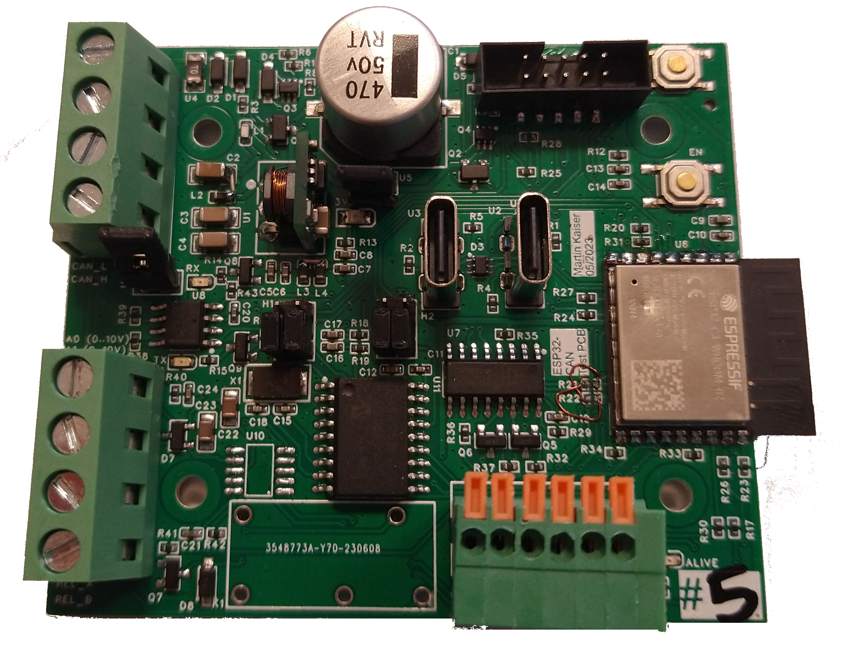
Jumper enables USB Power of USB prog CDC (USB Prog wrongly labelled as „UART“)
Left: USB C for UART (via CH340C) Right: USB C for Prog (via ESP CDC)
Note: PCB Labels „Prog“ and „UART“are switched :/
Jumper enables 120 Ohm Termination (between CAN_L
and CAN_H)
CAN Transceiver SN65HVD230
USB <> UART
CH340C
0..10V Analoge Out GP8403
Relay
CAN Controller MCP2515

Slide 5
VCC in: 5..28V
MYS Pin Header
Boot (hold while pressing EN to enter Boot mode)
GND
CAN L
CAN H
EN (press to restart)
3V3 LED
RX LED
Jumper
Jumper
TX LED
A0 out (0..10V)
Oopsie
A1 out (0..10V)
Relay
Spring Clamps
Alive LED
Relay

